Slide 1
Food Order & Delivery Database
Name: Xi Lin
Email: Xi.Lin-6@student.uts.edu.au
ID: 26028098
Project: Food Order & Delivery Database
Website: https://www.ubereats.com
Notes:
So, this is my personal information, and my project is food order and delivery database.

Slide 2
Domain overview
Description:
This database is a simulated food order platform database including users, restaurants and couriers as three main entities.
Typical workflow:
Customer selects items from restaurant menu and places order for delivery. The platform processes the order information and payment, then assigns a courier to deliver the food.
Xi Lin-26028098
Notes:
This project is a food order and delivery system inspired by Uber Eats. The simulated database contains users, restaurants and couriers as three major entities. The typical workflow is not complex; a customer selects food items from restaurant menu in software, and platform processes the order and payment information, at last it assigns a courier to deliver the food.

Slide 3
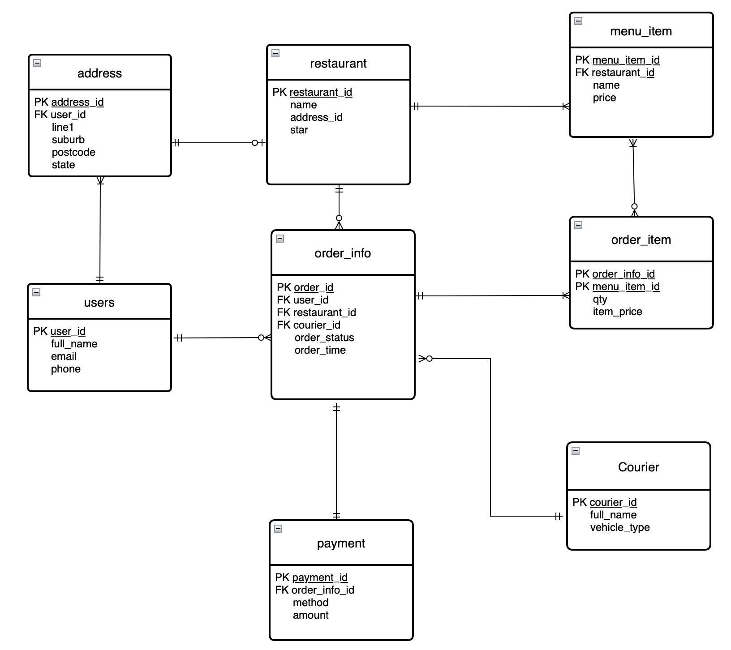
Xi Lin-26028098
Notes:
Based on these information, I construct an Entity Relationship Diagram like this. There is one thing I would like to specifically mention, that is I split the order information and items in the order as two entities to avoid data redundancy. The oeder_item table serves as a junction table between order_info and menu_item to handle the M:N relationship between them.

Slide 4
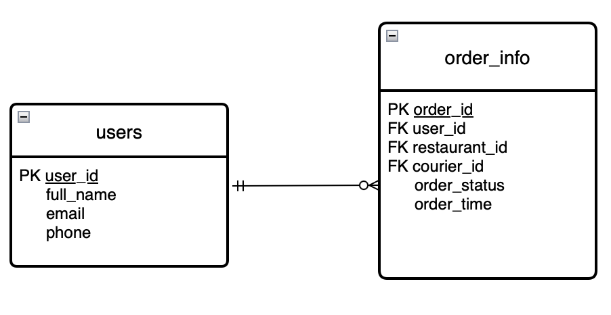
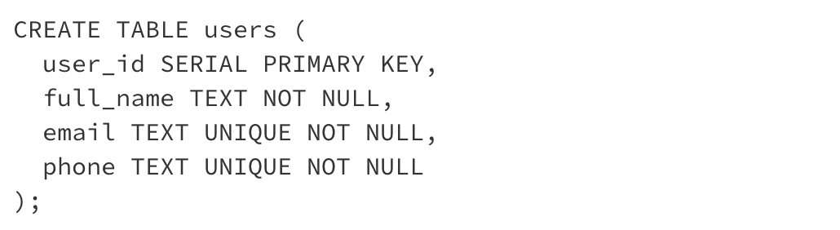
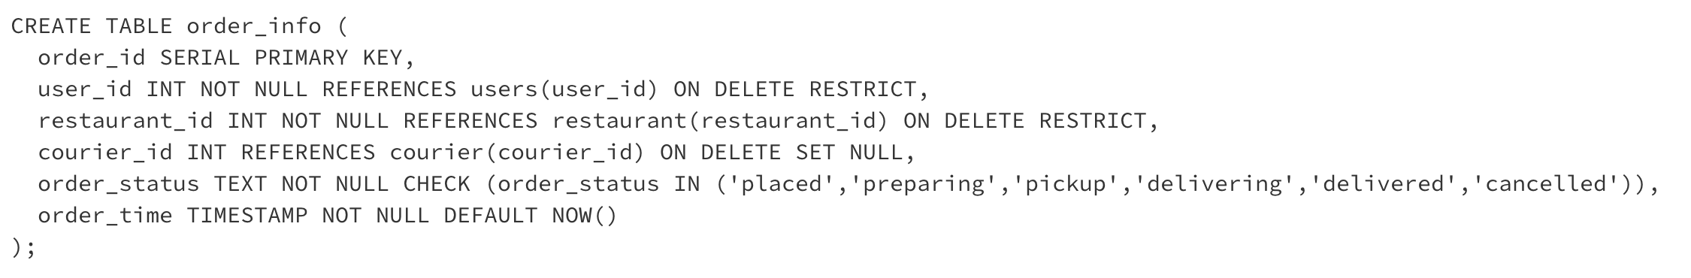
The 1:M relationship here is the users & order_info relationship, because one user can have multiple orders, but one order must belong to exact one user.
Xi Lin-26028098
Notes:
This is the 1:M relationship I choose, the users and order_info relationship, because one user can have 0 to multiple orders, but one order must belong to exact one user.

Slide 5
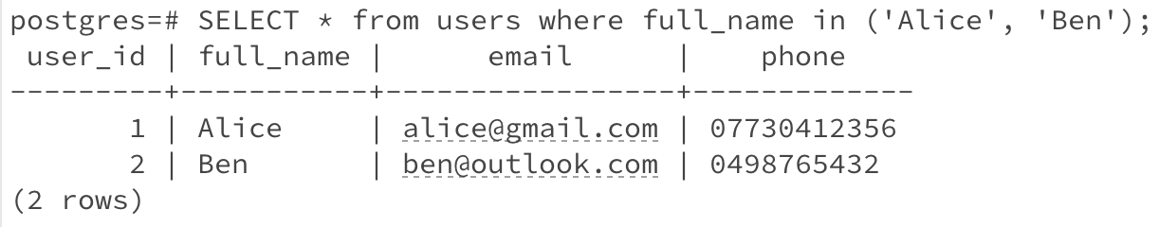
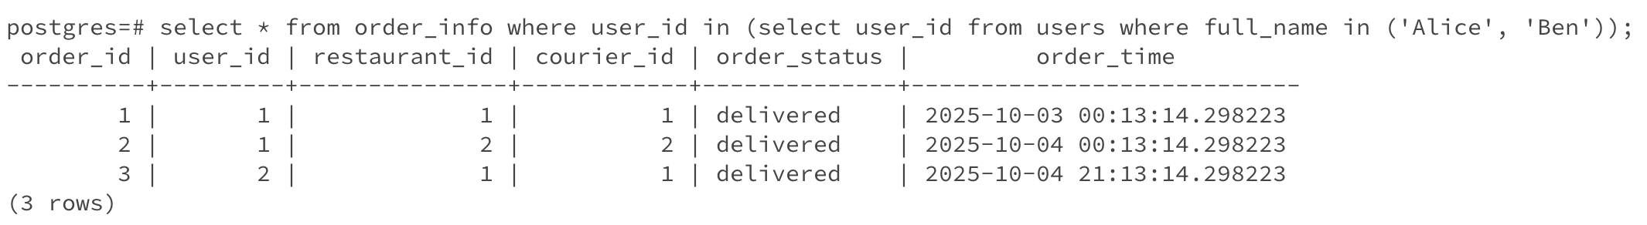
In this example, user ‘Alice’ has two orders, ‘Ben’ takes one order, and each order belongs to one user.
Xi Lin-26028098

Slide 6
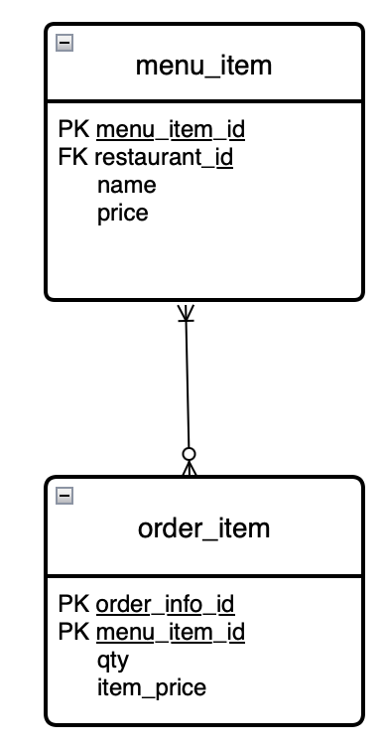
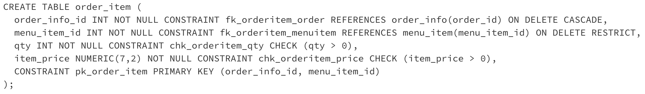
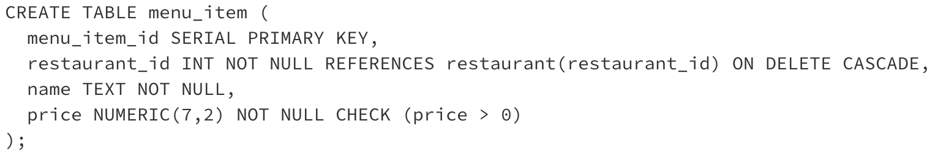
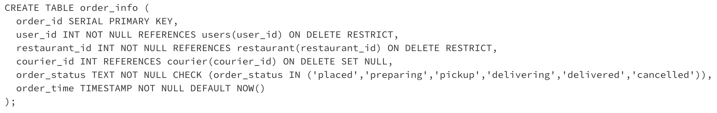
This is an M:N relationship, as one order should have at least one item, and one item can appear in any number of different orders.
Xi Lin-26028098

Slide 7
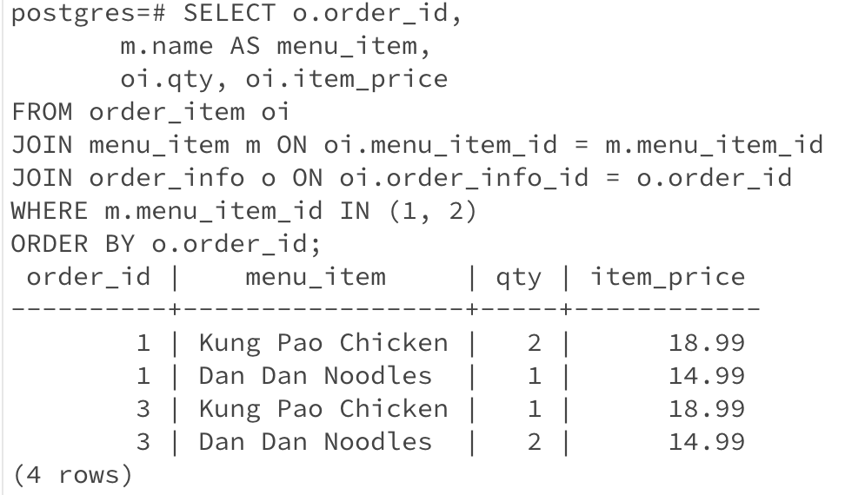
This command is to find all orders containing “Kung Pao Chicken” or “Dan Dan Noodles”. Here, the item “Dan Dan Noodles” appeared in order 1 and 3, while order 1 contains two items, which indicates that it is an M:N relationship.
Xi Lin-26028098

Slide 8
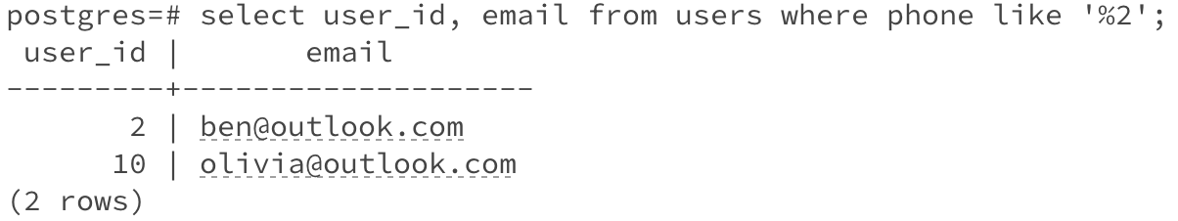
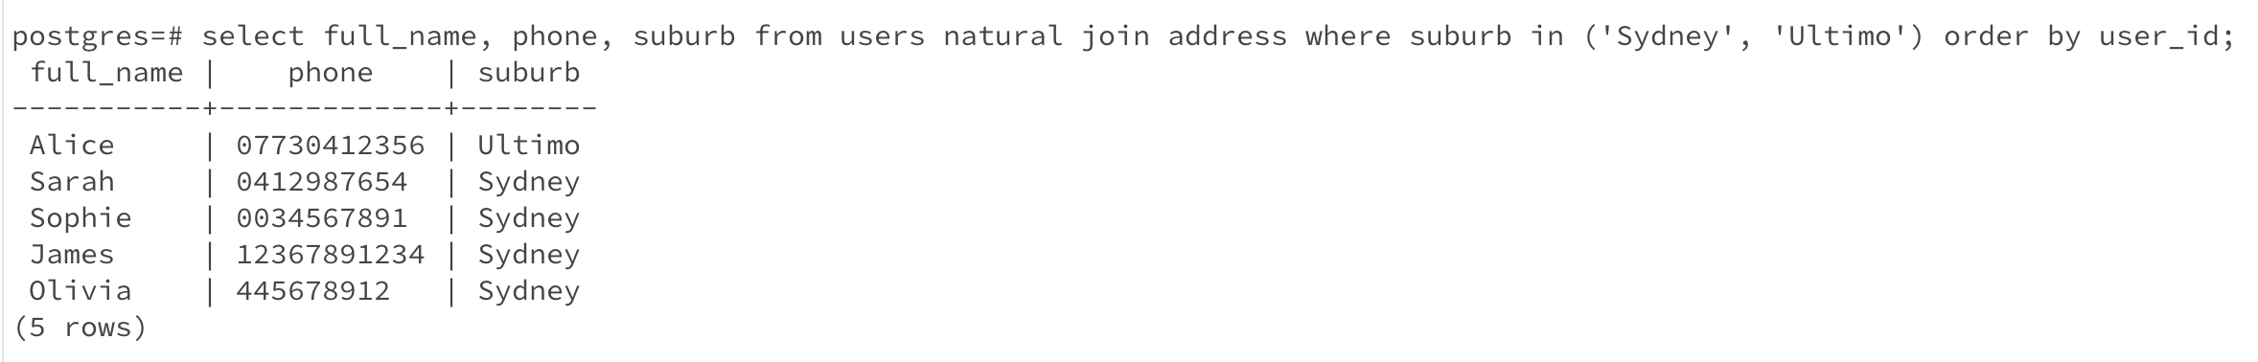
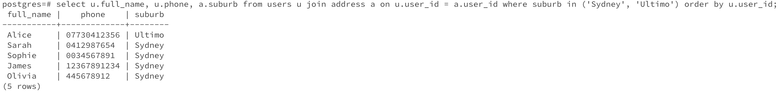
Simple query: List the user id and email of all users with phone number ending with “2”.
Natural join: List the name , phone and suburb of users who live in Sydney or Ultimo.
Cross product: List the name , phone and suburb of users who live in Sydney or Ultimo.
Xi Lin-26028098

Slide 9
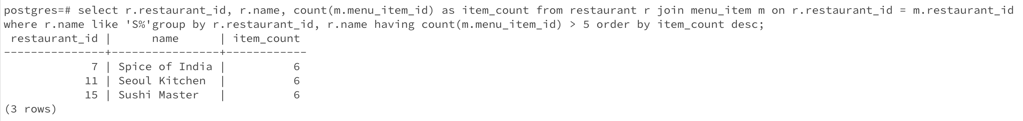
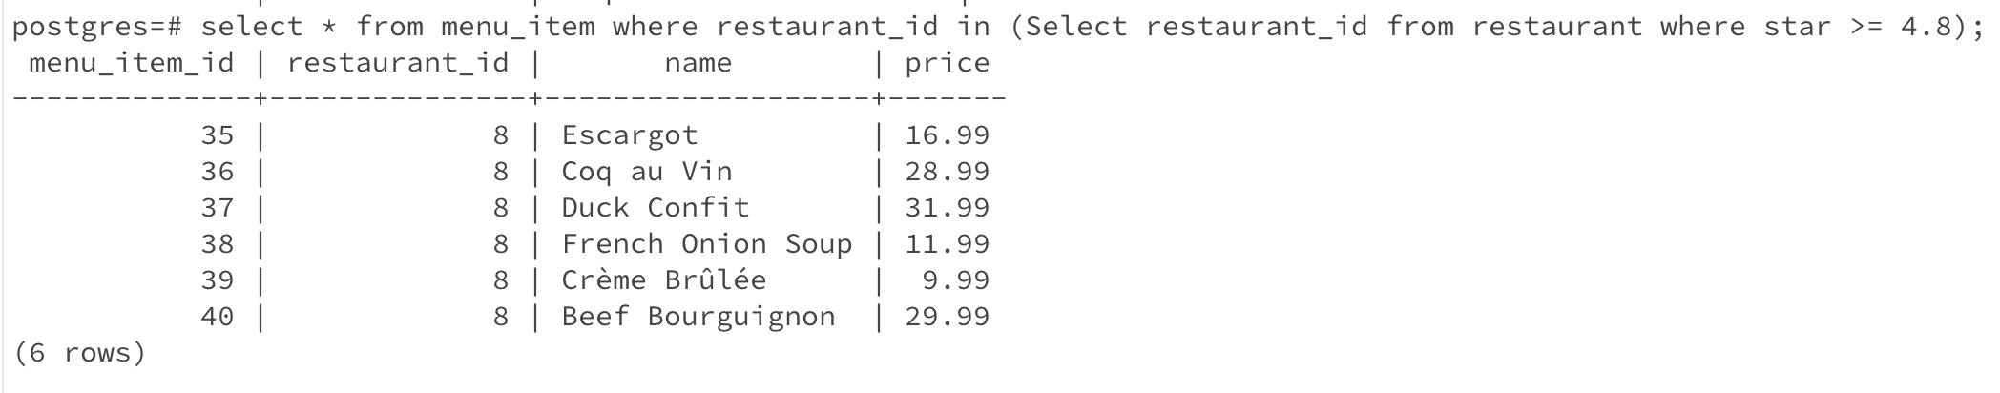
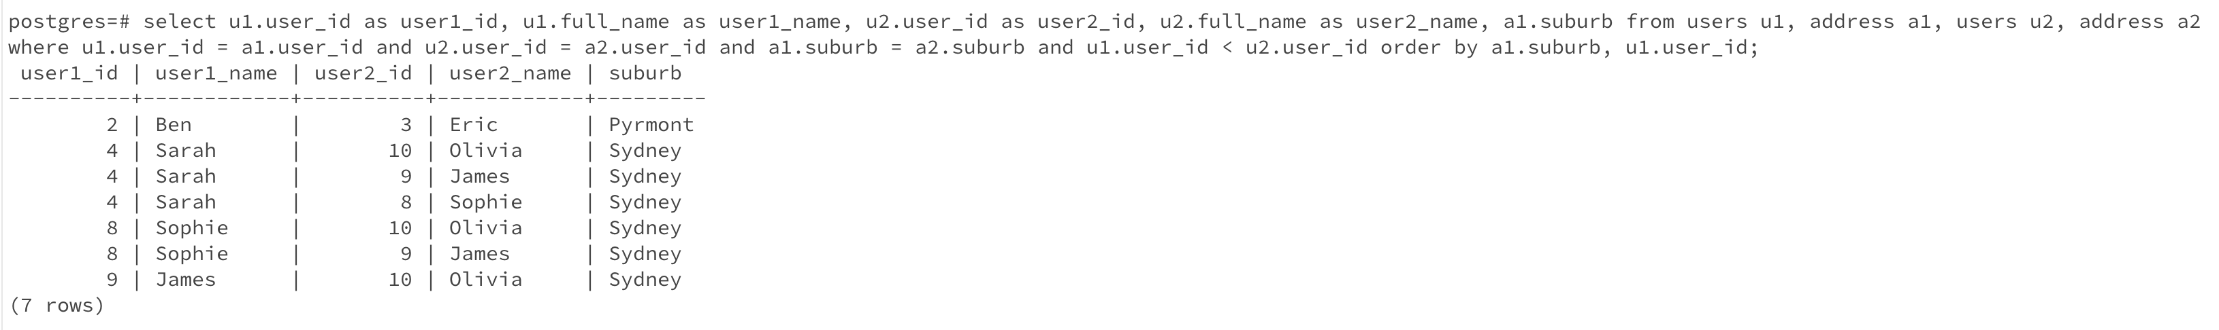
Group by & Having: List restaurant id, name and number of items of the restaurant with more than 5 items and name starting with S.
Sub query: List the item of restaurant with star no less than 4.8.
Self join: List the the pair of users who live in the same suburb.
Xi Lin-26028098

Slide 10
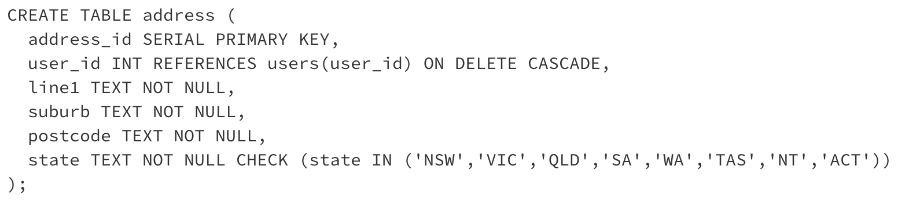
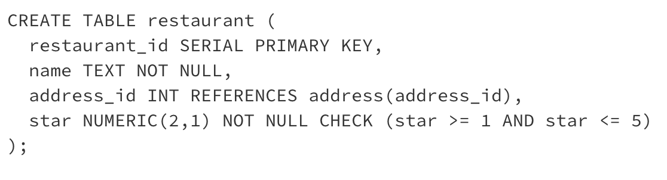
Check statement:
Check the state entered is a valid state in Australia.
Check the rate of restaurant is between 1-5.
Xi Lin-26028098

Slide 11
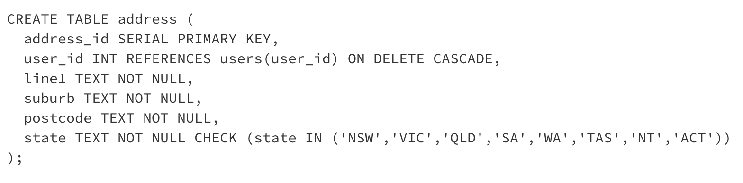
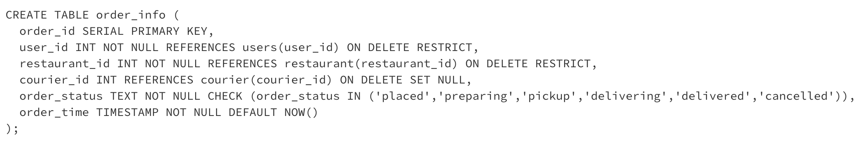
On delete cascade: This ensure once a user is deleted, the address related to him is deleted as well.
On delete restrict: Prevent the deletion of a user or a restaurant if there are still related rows in the order_info table.
Xi Lin-26028098

Slide 12
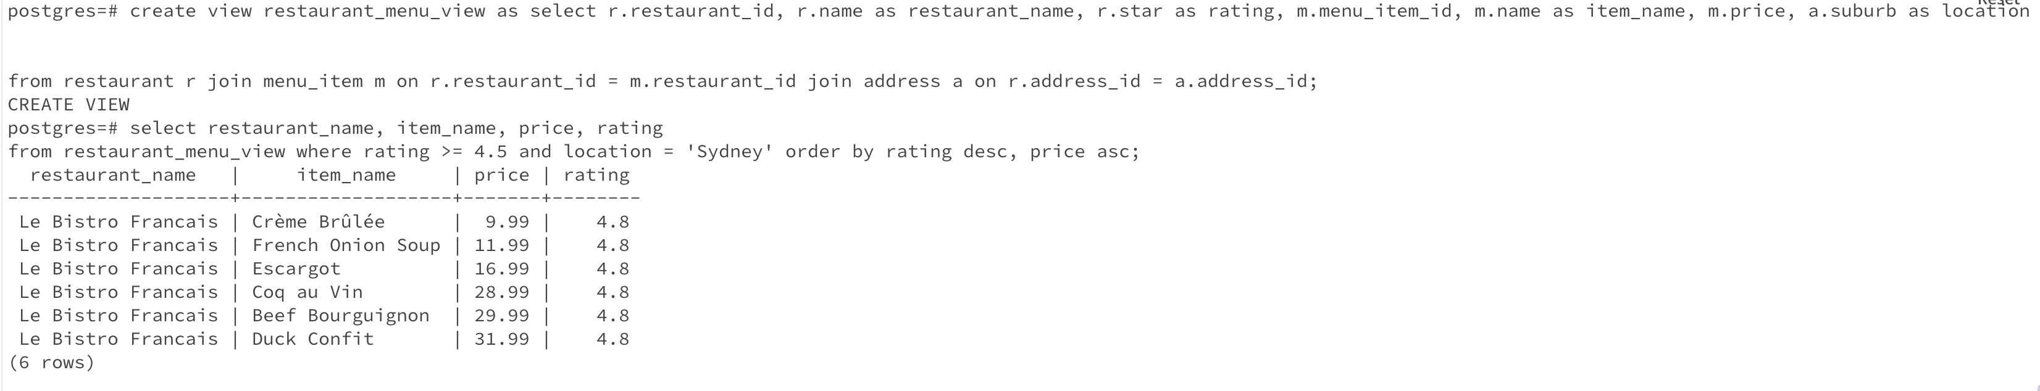
This view lists all the items from highly rated restaurants.
Xi Lin-26028098

